Slide 1
Cheat Card Game
Taylor Boling, Justin Lee, Josh Sample, Jack Thurber

Slide 2
Introduction
Cheat Card Game by Taylor Boling, Justin Lee, Josh Sample, and Jack Thurber
Cheat is a card game about bluffing. The goal is for a player to get rid of all their cards, sometimes having to lie to the opponent about what card is being played.

Slide 3
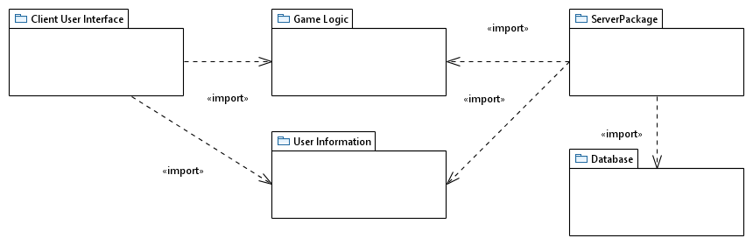
Package Diagram

Slide 4
Database Design Diagram
Username
Password
Users

Slide 5
Functional Requirement Example
When a server is started create the full deck of cards either hearts diamonds clubs or spades. Once created shuffles the deck. (createFullDeck use case)

Slide 6
A use Case Description Example
Use Case Name: createFullDeck
Actors: Server
1. The server is started
2. Deck of cards is created
3. Deck is shuffled
Entry Condition:
The server has started
Exit Condition:
The server closes

Slide 7
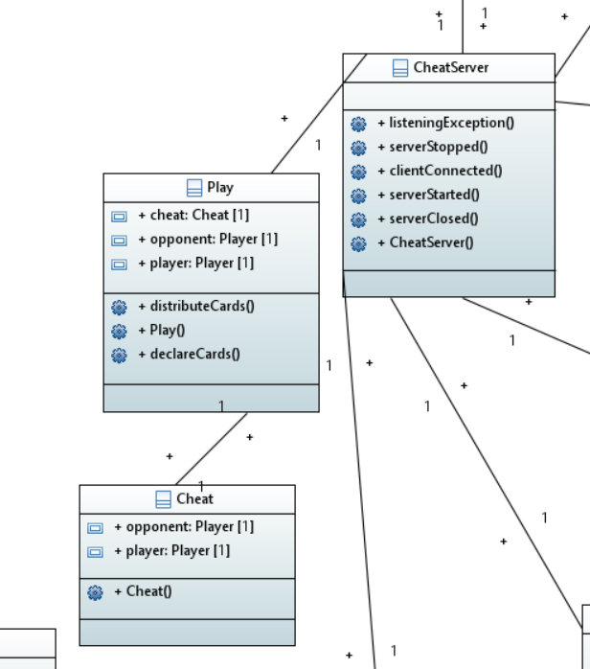
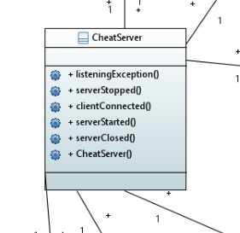
Class Diagram Example

Slide 8
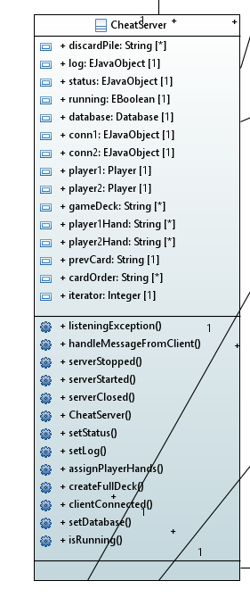
Final Class Diagram

